Slide 1

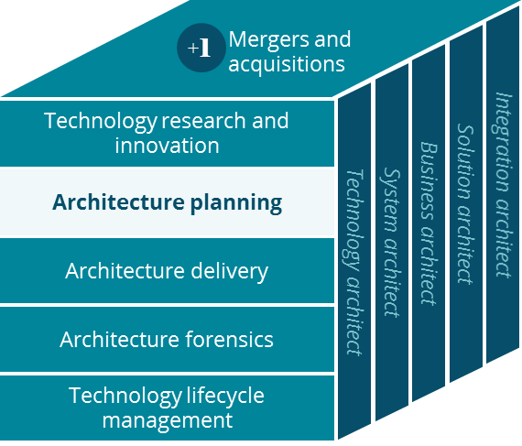
MinuteClinicBusiness Canvas
Architecture Planning
Ravi Vangala
5/16/2019

Slide 2
MinuteClinic Business Canvas
Holistic view of the current MinuteClinic business model
Key Partnerships
Key Activities
Value Proposition
Customer Relationships
Customer Segment
Clinical affiliations (Cleveland Clinic, 70+ other).
Health diagnosis
Vaccination
Provides on-demand
access to primary care at the convenience of patient
Patients
US domestic population in need of diagnosis and treatment services for common illnesses and vaccinations
Screenings & monitoring
Wellness & Physical
Affordable care, transparent fees, and less expensive than primary care physician
Doctors & affiliations
Primary care doctors
(via Epic care everywhere or manual CCR/fax)
Inventory management
Illness & injury treatment
Health plans & Providers (electronic data xfer)
Health Hub engagement
7M patient visits per year, 1,100+ locations, 7 days a week, no appointment necessary
Channels
Key Resources
In person
Email
HealthTag program for clients and health plans
One stop medical center- for fast, cost-effective, convenient,
reliable diagnosis and treatment services for common illnesses and vaccinations
Skilled nurse practitioners
Local real-estate
Phone, text
Web/ Mobile app
Suppliers
Supply-chain & Logistics
Telemedicine
Video Visit
Cost Structure
Revenue Streams
Wages for nurse practitioners
Our customers pay us by leveraging their health insurance services as well as their portion of the co-payment via cash or credit/debit cards
Store real-estate is very expensive especially in urban areas.
Health plans and clients pay us for exchanging health records and for providing HealthTag services

